Slide 1
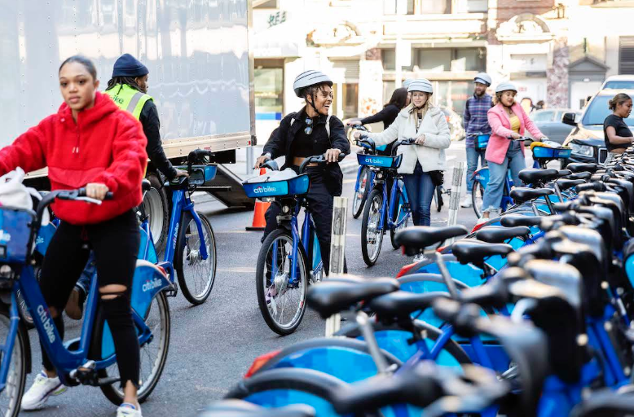
CitiBike Case Study

Slide 2
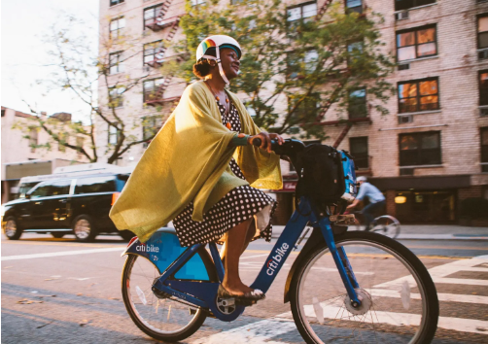
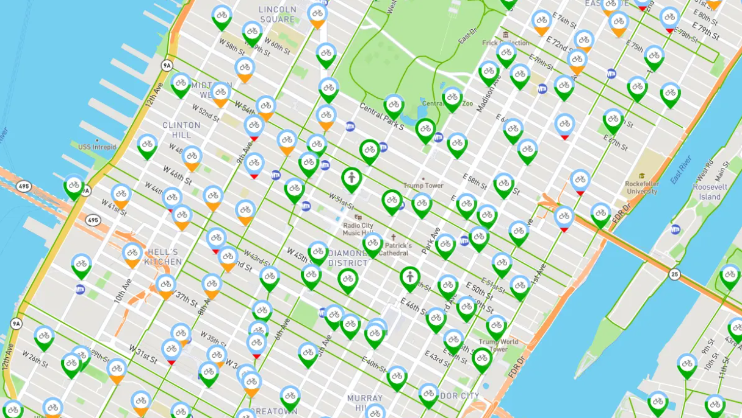
Objective and question
Objective:
To find the number of bikes to stock in each station at the beginning of the day to maximize the number of daily bike trips.
Questions:
• How many trips between stations (demand* for bikes) every day (morning and evening)?
• How many bikes do we have to allocate to each station?
*Demand between stations in a day: number of trips between two stations in that day
2
CitiBike Case Study

Slide 3
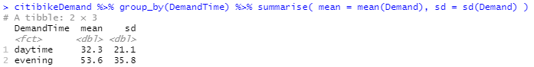
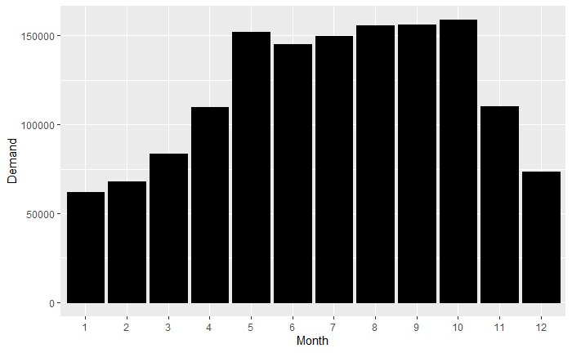
What did you find in the data
Mean value of ‘Evening’ demand is higher than ‘Daytime’ demand
The Evening demand is higher than the Daytime demand every month.
The highest demand of Daytime is in May, Evening is in October.
3
CitiBike Case Study

Slide 4
Evidence from Descriptive Analysis
4
CitiBike Case Study

Slide 5
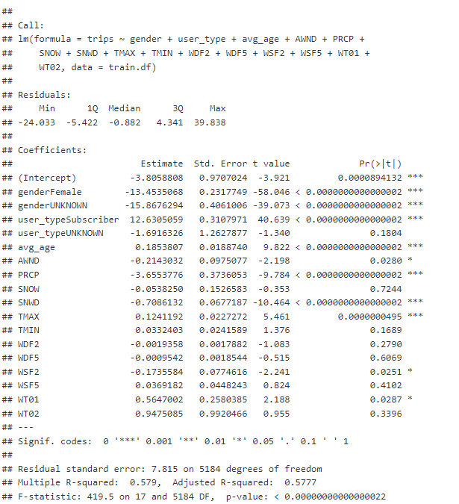
Evidence from Predictive Analysis
We encountered several restrictions in dataset collecting and manipulations in our CitiBike predictive research, which are outlined below, and a roadmap for future development will be addressed.We only had daily weather reports.
Thus we could not undertake weather-based hourly or peak-hours predictive analysis.
Because the format of the CitiBike dataset changed from month to month, AWS Athena was unable to upload the data fully.
So we used a deterministic process to sample the data, taking each 1000th value from the data files.
5
Click Insert > Header & Footer to add Area/Division/Department name.

Slide 6
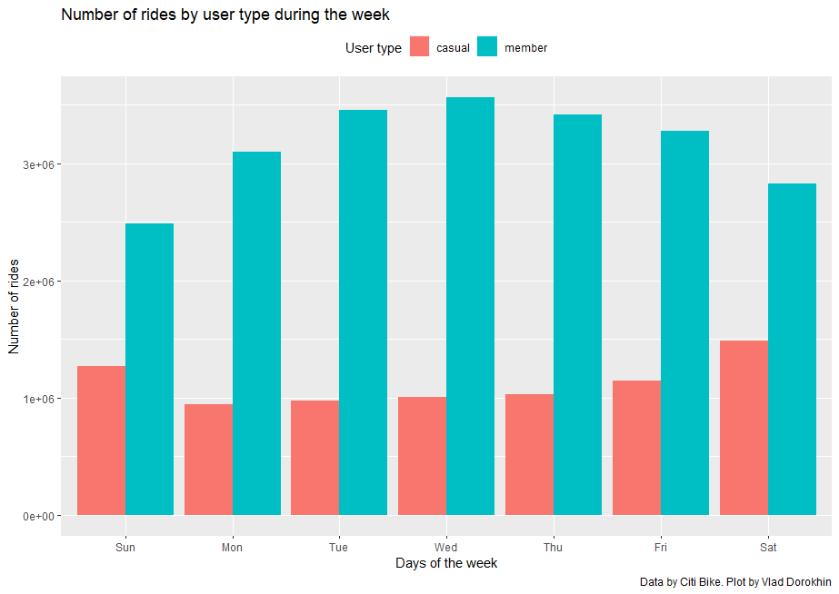
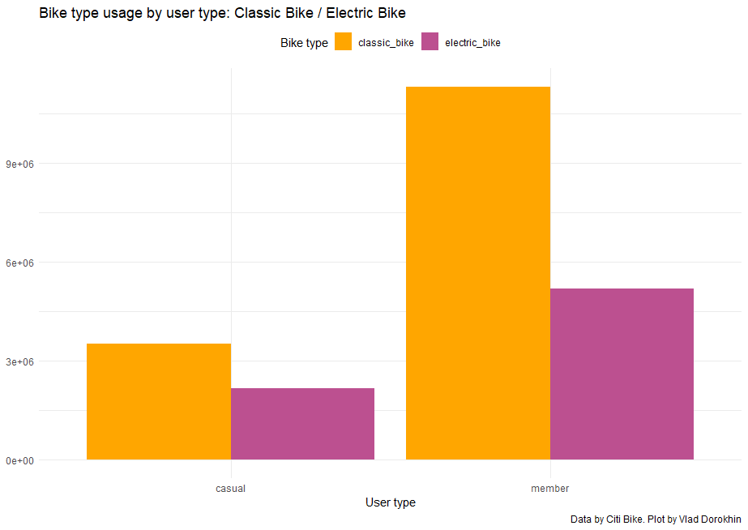
Members take far more bike trips than casual users during the week.
Members make the most trips on Wednesdays (the middle of the workweek) and the fewest on Sundays.
In general, members travel more during the workweek than on weekends.
Classic bikes are used far more frequently by both casual users and members than electric bikes!
Members ride electric and classic bikes far more than casual users.

Slide 7
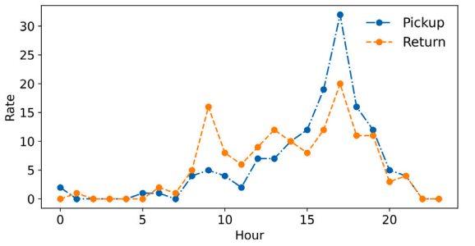
Evidence from Prescriptive Analysis
Most importantly, present research ignores the linkages between prediction and decision-making tasks, instead focusing on either prediction or decision performance in isolation.
Motivated by this, a thorough knowledge of how prediction features affect downstream decision-making processes is critical.
As a result, the remainder of this section delves deeper into this occurrence.
7
Click Insert > Header & Footer to add Area/Division/Department name.

Slide 8
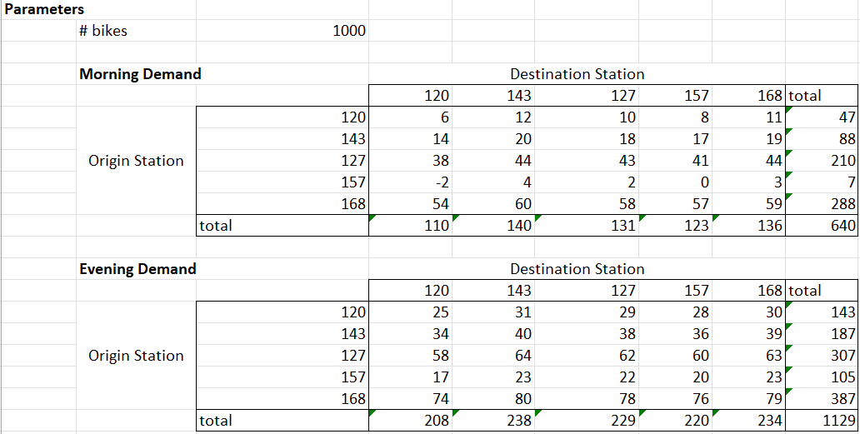
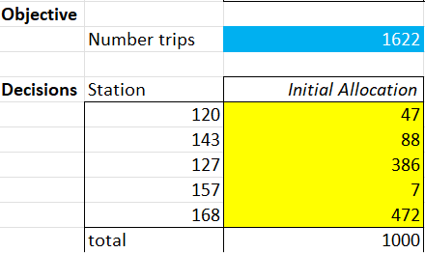
Predict the Daytime and Evening demand a day

Slide 9
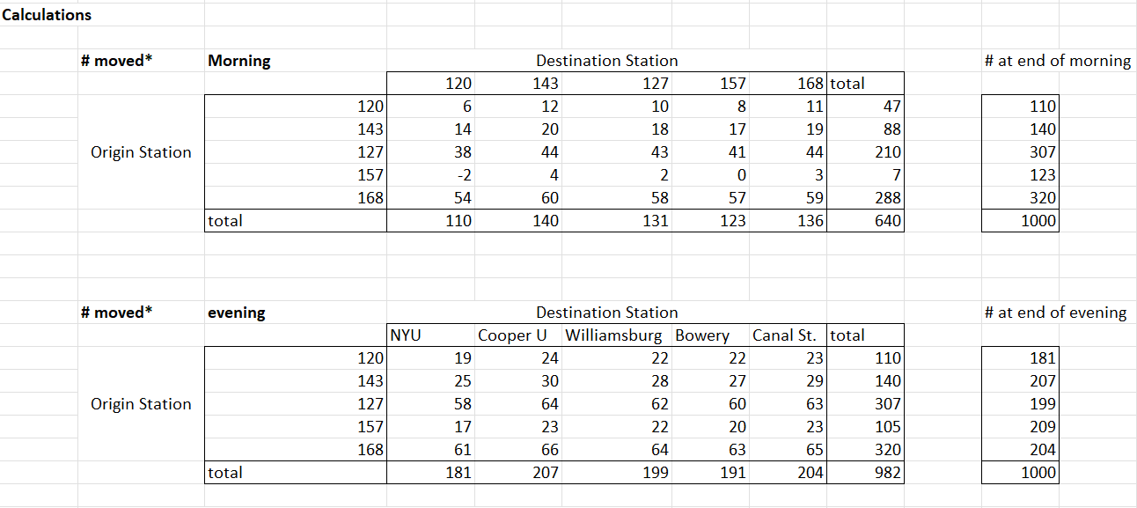
Evidence from Prescriptive Analysis

Slide 10
Final Recommendation
The most popular classic bike routes are in the Lower East Side near the Williamsburg Bridge, the Kips Bay neighborhood, the Chelsea neighborhood, the Lincoln Tunnel, and East Harlem.
The most popular docked bike routes are in the Chelsea district and the Yorkville neighborhood. A large portion of Central Park is also home to several famous docked bike lanes.
The most popular electric bike routes are around the Pulaski Bridge, the Garment District, and the Financial District, close to One New York Plaza.
This is a great development because a 45-minute journey is evaluated the same surcharge as a 59-minute one under the current approach.
In all the stations the no of bikes will same in the week 1 later on we can see the scenario of the no of bike used particularly which places we’re been used the most according we can arrange them Like in weekdays in office or schools and colleges like In weekend in public places like parkes movie theatres.

